Slide 1

PUBLIC OBJECTION BY CRIMINAL TO POLICE HEADQUARTERS SHORT A WAY SET CASUALTY
TEAM MEMBERS: GUIDED BY:
PAVITRAA D S B 211420205106 Mrs.Priyadharshini M.Tech, B.Tech
SANGEETHA G 211420205131 ASSISTANT PROFESSOR
KAARTHIKA N 211420205070

Slide 2
ABSTRACT
This project aims to address the public objection process in criminal cases by providing a secure and efficient system utilizing Java programming language and the SHA-256 algorithm of the blockchain as AES algorithm
The system includes a complaint registration page for users, as well as modules for the police headquarters and the police stations.
The system ensures the authenticity and integrity of objection submissions by leveraging the blockchain’s decentralized and immutable nature.
The SHA-256 algorithm provides a robust cryptographic mechanism for securing data and maintaining the integrity of the objection records.

Slide 3
The complaint registration page allows users to securely access the system and submit their objections to the police stations.
The system incorporates modules specifically designed for the police headquarters and the admin to handle and process the objections efficiently.
By utilizing the block chain technology, the system ensures transparency and accountability throughout the objection process.
Each objection submission is recorded on the block chain, making it tamper-proof and verifiable.
This enhances trust between the public and the police authorities, as well as streamlines the objection handling process.
We also implemented an additional verification for the family or the person who is affected, where for filling an case in court they can get the case files from the headquarters by providing the required documents and which generates a QR code by scanning it they get a code.
That code after verification they get the case files from the headquaters

Slide 4
OBJECTIVE & SCOPE
OBJECTIVES:
Develop a secure and transparent complaint registration system using blockchain technology, ensuring that users can register complaints and track their status accurately
Strengthen data security by leveraging blockchain's tamper-proof nature, protecting sensitive information while allowing authorized parties to access necessary details for complaint resolution.
Streamline the objection handling process by providing an efficient admin panel for administrators to respond promptly, resulting in improved complaint resolution times and customer satisfaction
Addressing Public Objection Process
Ensuring Authenticity and Integrity using QR code verification
Cryptographic Security with SHA-256 and AES algorithm.

Slide 5
SCOPE OF THE PROJECT:
User-Focused System: The project focuses on providing a user-centric system with a secure and easy-to-use interface for individuals submitting objections related to criminal cases.
Integration of Blockchain Technology: The project involves the integration of blockchain technology, specifically the SHA-256 algorithm, to ensure the security and integrity of objection records.
Roles for Police Headquarters and Admin: The system includes specific modules designed to cater to the needs of both the police headquarters and the admin, ensuring efficient processing of objections.
End-to-End Objection Handling: The scope covers the entire objection handling process, from user registration and submission to the processing and recording of objections on the blockchain.
Enhancing Trust: The project aims to enhance trust between the public and law enforcement authorities by providing a transparent, accountable, and tamper-proof objection handling system.

Slide 6
LITERATURE SURVEY
S. No | Name of the paper with year | Objective | Pros | Cons
1 | BLOCKCHAIN-BASED SYSTEM FOR EFFECTIVE POLICE COMPLAINT MANAGEMENT,2023 | The primary objective is to introduce and propose a transformative solution that leverages blockchain technology for revolutionizing the police complaint management system. The focus is on creating a decentralized platform to ensure the integrity and immutability of complaint records, mitigating risks related to tampering and unauthorized access. This innovative approach aims to eliminate reliance on outdated manual processes, enabling secure remote filing of complaints and enhancing resilience and trust in the complaint management process. Ultimately, the primary goal is to address prevailing challenges in police complaint management and pave the way for a more accountable and transparent law enforcement ecosystem. | Enhanced Security Decentralization Remote Filing Tamper-Proof Records | User Adoption Integration with Existing Systems Interoperability Challenges

Slide 7
S. No | Name of the paper with year | Objective | Pros | Cons
2 | FIR SYSTEM USING BLOCK CHAIN TECHNOLOGY,2023 | The primary objective is to enhance the security and efficiency of handling crime records and digital evidence in police stations through the implementation of blockchain technology. The current system relies on FIRs, which are deemed less secure and susceptible to fraud due to manual updates. leverage blockchain technology to secure crime and criminal data, empower investigators, and optimize the handling of digital evidence within a distributed system setting. The proposed three-tier blockchain architecture aims to enhance both security and performance in managing and processing digital crime evidence | Increased Security Transparency and Trust Data Integrity and Scalability | User Training and Adoption Potential Privacy Concerns Risk of Over-Reliance

Slide 8
S. No | Name of the paper with year | Objective | Pros | Cons
3 | Police Complaint Management System Using Blockchain Technology, 2020 | The primary objective is to propose a blockchain-based solution for managing complaints related to both cognizable and non-cognizable offenses. The proposed system involves encrypting and storing FIRs in the InterPlanetary File System (IPFS), with the hash added to the blockchain network. This approach aims to create a tamper-proof and secure record of complaints. In case of police reluctance or denial to file an FIR, the blockchain provides strong proof for the complainant, as the complaint and its timestamp are securely stored, preventing any tampering or unnoticed alterations. | Blockchain technology secures data through cryptographic techniques, making it difficult for unauthorized individuals to alter or manipulate complaint records | Implementing a blockchain-based complaint management system introduces a dependency on the underlying technology

Slide 9
EXISTING SYSTEM
the key components of the study, which involves using personal information and GPS trajectories to extract features, representing individuals and locations as nodes in a network, and ultimately classifying crime risks based on these features.
A Multi-dimension Fusion Information Graph is constructed using these data sources. The proposed FIGAT model, based on graph neural networks, effectively .
Technique:
GPS, FIGAT TECHNOLOGY
Disadvantage :
Reliance on Personal Information and GPS Trajectories: FIGAT heavily relies on personal information and GPS trajectories for crime risk classification.
This dependence may limit its effectiveness if the data quality is compromised or if individuals provide inaccurate or incomplete information.

Slide 10
PROPOSED SYSTEM
This project introduces a Java-based system for public objections in criminal cases, leveraging the SHA-256 algorithm of block chain technology. The system includes login and registration pages, as well as modules for police headquarters and admin functions. By utilizing block chain’s decentralized and immutable nature, the system ensures secure objection submissions and maintains data integrity also provide QR code for verification purpose on headquaters
Technique:
SHA-256,AES
Advantage:
Using the SHA-256 algorithm for hashing in a decentralized system is a good practice for ensuring network integrity and security
Robust Cryptographic Security: SHA-256 offers strong cryptographic security, making it highly resistant to hacking and unauthorized access.
Its 256-bit hash function provides a high level of data integrity and protection against tampering

Slide 11
HARDWARE REQUIREMENTS:
The hardware requirements may serve as the basis for a contract for the implementation of the system and should therefore be a complete and consistent specification of the whole system. They are used by software engineers as the starting point for the system design. It shows what the system does and not how it should be implemented.
PROCESSOR : PENTIUM IV 2.6 GHz, Intel Core 2 Duo.
RAM : 4GB DD RAM
MONITOR : 15” COLOR
HARD DISK : 40 GB

Slide 12
SOFTWARE REQUIREMENTS:
The software requirements document is the specification of the system. It should include both a definition and a specification of requirements. It is a set of what the system should do rather than how it should do it. The software requirements provide a basis for creating the software requirements specification. It is useful in estimating cost, planning team activities, performing tasks and tracking the team’s and tracking the team’s progress throughout the development activity.
Front End : J2EE(JSP,SERVLETS) , JAVASCRIPT
Back End : MY SQL 5.5
Operating System : Windows 07
IDE : Eclipse

Slide 13
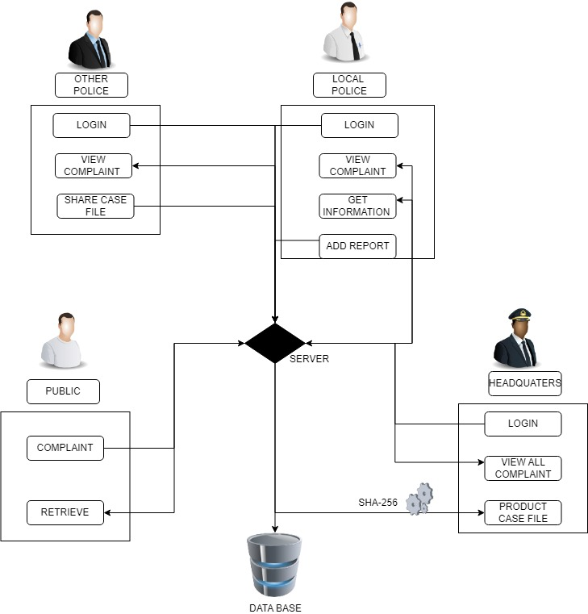
ARCHITECTURE DIAGRAM

Slide 14
ALGORITHM/METHODOLOGY
SHA-256 is a cryptographic hash function that takes an input (message) and produces a fixed-size output hash value (256 bits or 64 hexadecimal characters). It is designed to be a one-way function, meaning it should be computationally infeasible to reverse the process and derive the original input from the hash.The SHA-256 algorithm follows these main steps:
Padding: If needed, the input message is padded to ensure its length is a multiple of 512 bits.
Initialization: Initialize the hash values (H0 to H7) with the initial hash values specified in the SHA-256 standard.
Processing Blocks:
Divide the padded message into 512-bit blocks.
Extend the 512-bit block into 64 words.
Process each 512-bit block with a set of logical functions and constants in multiple rounds.
Message Schedule:
Generate a message schedule array (W) from the 512-bit block.
Compression Function:
Update the hash values through a series of bitwise operations, logical functions, and constants.
Final Hash:
The final hash value is obtained by concatenating the updated hash values H0 to H7.

Slide 15
AES operates on blocks of data and supports key sizes of 128, 192, or 256 bits. The algorithm consists of several key steps:
Key Expansion:The original key is expanded into a set of round keys using a key expansion schedule.
Initial Round Key Addition:The first round key is added to the input data.
Rounds:Multiple rounds (10, 12, or 14 depending on the key size) are performed, each consisting of the following steps:
SubBytes: Non-linear substitution step where each byte in the block is replaced.
ShiftRows: Bytes in each row are shifted by varying offsets.
MixColumns: Transformation mixing data in each column.
AddRoundKey: Round key is XORed with the block.
Final Round:The final round excludes the MixColumns step.
Final Output:The final output represents the encrypted (or decrypted) data.
The AES encryption for one round can be represented as:
AES(X,K)=AddRoundKey(MC(S(SR(X))),K)
Where: X is the input data block, S is the SubBytes operation, SR is the ShiftRows operation, MC is the MixColumns operation, K is the round key.

Slide 16
NOVELTY
Blockchain Integration: The use of blockchain technology, specifically the SHA-256 algorithm, adds a novel layer of security and integrity to the objection handling process, ensuring records are tamper-proof and verifiable.
Decentralized and Immutable Nature: Leveraging the decentralized and immutable nature of blockchain provides a unique solution for maintaining the authenticity of objection records, addressing potential concerns related to data manipulation.
Transparency and Accountability Features: The project's emphasis on transparency and accountability throughout the objection process distinguishes it by fostering trust between the public and law enforcement authorities.
Efficiency with Specific Modules: The inclusion of dedicated modules for the police headquarters and admin streamlines the objection handling process, making it more efficient and tailored to the needs of different stakeholders.
Cryptographic Security: The use of the SHA-256 algorithm as a robust cryptographic mechanism ensures the security of objection data, providing an additional layer of protection against unauthorized access or manipulation.
QR code verification: Using QR code the authentication and security of the objection is protected

Slide 17
MODULES
PUBLIC
LOCAL POLICE
OTHER POLICE STATION
POLICE HEADQUARTERS
PUBLIC COMPLAINT ABOUT CRIME
LOCAL POLICE UPLOAD REPORT

Slide 18
MODULES DESCRIPTION
PUBLIC: In this application public don’t need any register and login process. They are straightly move forward to public home page and able to use all features like home,cpomplaint,reports
LOCAL POLICE: Local police need to enter username and secret word for open their landing page after that they can see all grumblings.
OTHER POLICE STATION:Nearby police need to enter username and secret word for open their greeting page after that they can see all grumblings and contrast with their data set assuming any case record matches that case they are quickly send that case report to neighborhood police station.
POLICE HEADQUARTERS:Headquarters is one of the model this application it have secret username and secret phrase to open their point of arrival. It will keep the Case records securely.
PUBLIC COMPLAINT ABOUT CRIME:Public if want to make complaint about crime they are should fill the complaint form. That complaint form contains few input tags. public have to enter personal details and crime details.
LOCAL POLICE UPLODAD REPORT: Nearby police need to enter the username and secret phrase to open their point of arrival and afterward if get any data from different stations make the prompt move and report to the base camp about wrongdoing subtleties

Slide 19

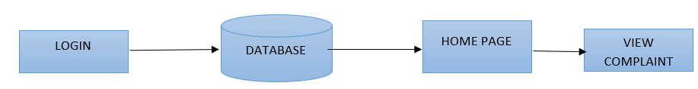

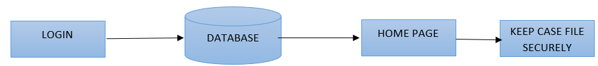
PUBLIC:
LOCAL POLICE:
OTHER POLICE STATIONS:
POLICE HEADQUARTERS:

Slide 20
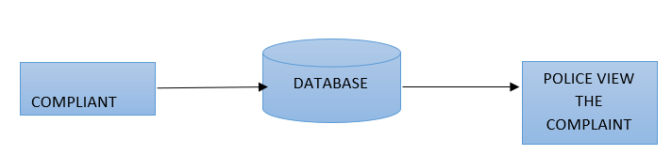
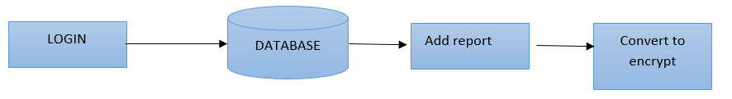
PUBLIC COMPLIANT ABOUT CRIME:
LOCAL POLICE UPLOAD REPORT:

Slide 21
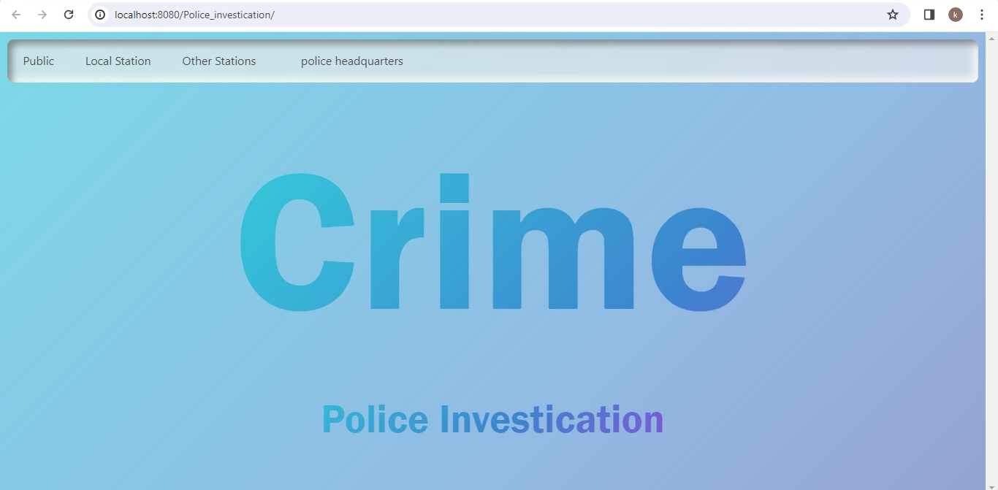
SNAPSHOTS

Slide 22
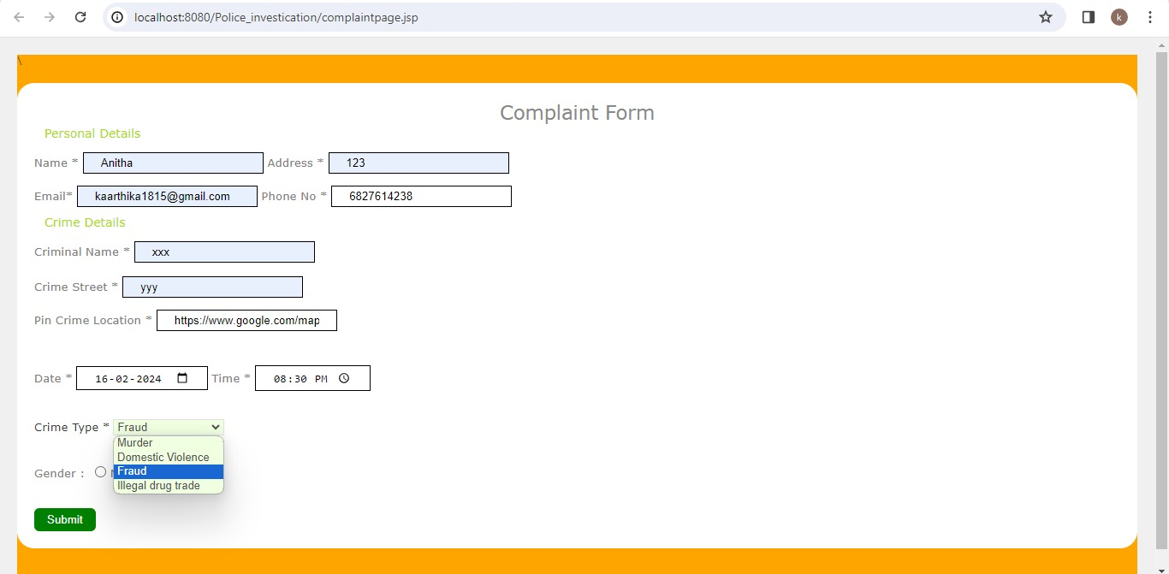

Slide 23
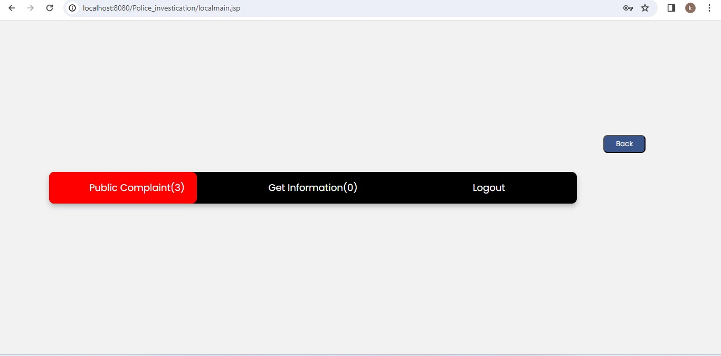
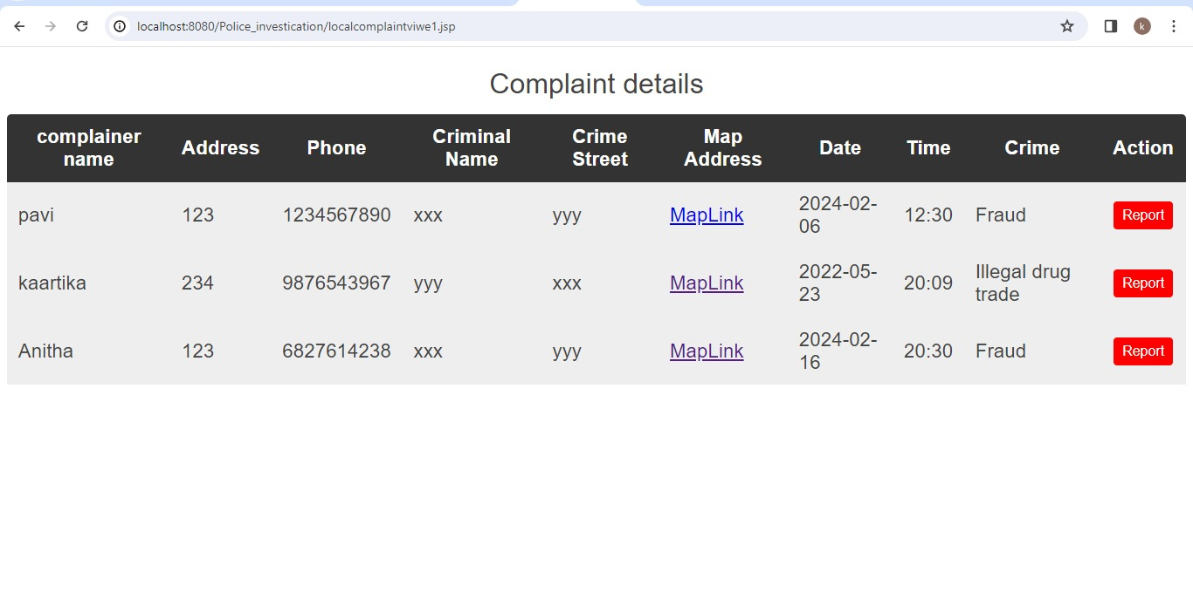

Slide 24
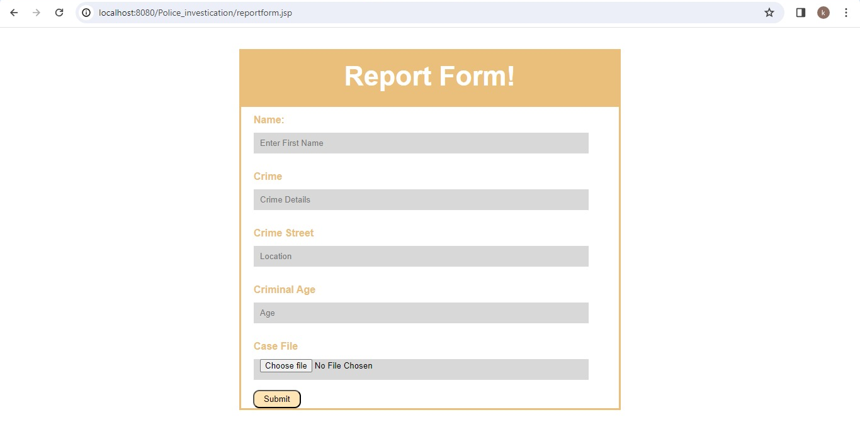

Slide 25
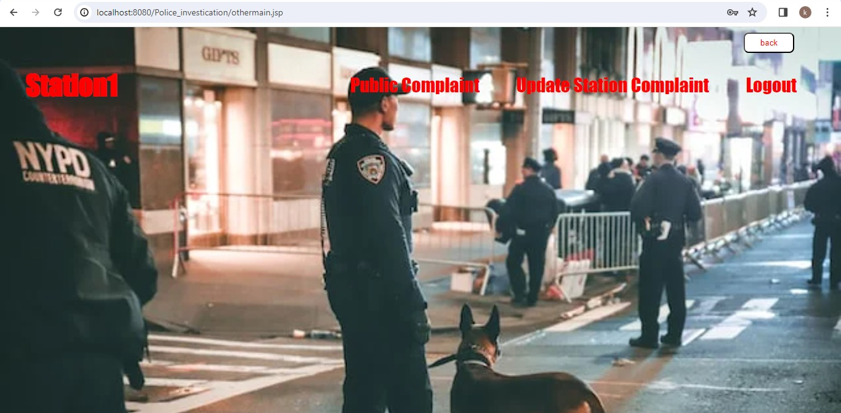
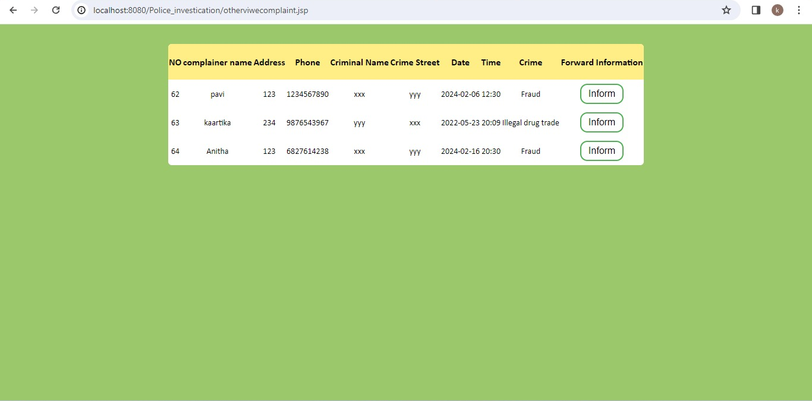

Slide 26
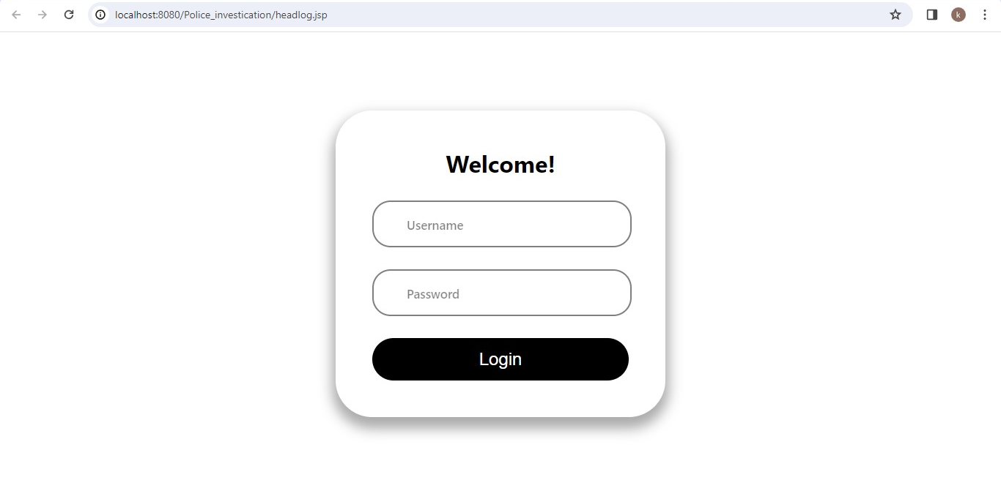

Slide 27
REFERENCES
[1]AN IMPLEMENTATION OF BLOCKCHAIN TECHNOLOGY IN FORENSIC EVIDENCE MANAGEMENT G.Vasavi[1], Dr. G Kalpana [2] M.Tech[1], Professor of CSE [2] Department of Computer Science and Engineering, IJCRT | Volume 11, 8 August 2023
[2]BLOCKCHAIN-BASED SYSTEM FOR EFFECTIVE POLICE COMPLAINT MANAGEMENT Lynsha Helena Pratheeba HP, Associate professor, Bharath D R, Cibiya N E, Dheekshitha S, Divya M N, Department of Computer Science and Engineering, Journal of Emerging Technologies and Innovative Research, Volume 11 | Issue 3 June 2023
[3]Blockchain-driven Evidence Management System by Shyam Mehta; K. Shantha Kumari; Paras Jain; Harshal Raikwar; Shubham Gore, 3rd International Conference on Artificial Intelligence and Signal Processing (AISP),01 June 2023
[4]FIGAT: Accurately Classify Individual Crime Risks With Multi-Information by Fusion Wenbo Xu, Peiyi Han, Shaoming Duan, and Chuanyi Liu, IEEE Transactions on Services Computing pp. 1890-1903, vol. 16, June 2023
[5]FIR SYSTEM USING BLOCKCHAIN TECHNOLOGY Bharath Kumar V, Dr. Mir Aadil, International Journal of Advanced Research in Computer and Communication Engineering Vol. 12, Issue 3, March 2023

Slide 28
[6]Derick Anderes, Edward Baumel, Christian Grier, Ryan Veun and Shante Wright, "The Use of Blockchain within Evidence Management Systems". IJCRT | Volume 10, Issue 6 June 2022
[6]Impact of Crime Reporting System to Enhance Effectiveness of Police Service, KN Jayasinghe #1, MPL Perera#2, International Journal of Computer Trends and Technology Volume 69 Issue 5, May 2021
[7]The Application of Blockchain of Custody in Criminal Investigation Process, Fu-Ching Tsai*, Department of Criminal Investigation, Central Police University, Taoyuan City 33304, Taiwan Volume 192, 2021
[8]Revathy Sathyaprakasan Pratheeksha Govindan, Samina Alvi, Lipsa Sadath, Sharon Philip and Nrashant Singh, "An Implementation of Blockchain Technology in Forensic Evidence Management". 2021 International Conference on Computational Intelligence and Knowledge Economy (ICCIKE),2021
[9]D. Kim, S. Y. Ihm, and Y. Son, "Two-level blockchain system for digital crime evidence management", Sensors, vol. 21, no. 9, pp. 3051, 2021.
[10]Police Complaint Management System Using Blockchain Technology, Ishwarla Hingorani, Rushabh, Khara, Deepika, Pomendkar, Nataasharaul, 2020

